Slide 1
Recognizing grammatically correct sentences
Alekhya Dronavalli

Slide 2

Introduction
Goals:
To train a model that predicts if a sentence is grammatically correct or not.

Slide 3
Background

Slide 4
Sentence Grammar Classification
The task of recognizing grammatically correct sentences involves automatically Determining whether a given sentence conforms to the rules and conventions of a particular language’s grammar.

Slide 5
Model

Slide 6
Model
BERT is a pre-trained language model that has achieved state-of-the-art performance on various NLP tasks, including sentence classification.

Slide 7
Model
BERT is a pre-trained language model that has achieved state-of-the-art performance on various NLP tasks, including sentence classification.
BERT model is fine-tuned on a corpus of annotated sentences to learn the specific features that are indicative of grammatical correctness. During inference, the fine-tuned BERT model takes in a sentence as input and outputs whether the sentence is grammatically correct.

Slide 8
Methodology

Slide 9
Experimental setup
Sentence Grammar Classification
A json formatted file with sentence and a tag
Eg: {
"sentence": "A major change of direction is needed in Britain if it is to prosper, the shadow chancellor said as the Tory Party spring conference began.",
"tag": false
}

Slide 10
Experimental setup
Dataset | #Labels | No of Examples
Train | 2 | 6769
Test1 | 2 | 996
Test2 | 2 | 999

Slide 11
Experimental setup
Performance Metrics
Accuracy
Matthew's correlation coefficient (MCC)
MCC is a metric that takes into account both true and false positives and negatives in a binary classification problem. It ranges from -1 to 1, where a score of -1 indicates perfect disagreement between the predicted and true labels, 0 indicates random guessing, and 1 indicates perfect agreement.

Slide 12
Results

Slide 13
Results
Dataset | #Labels | No of Examples | Accuracy | Mcc
Train | 2 | 6769 | 0.95
Test1 | 2 | 996 | 0.99 | 0.98
Test2 | 2 | 999 | 0.98 | 0.95

Slide 14
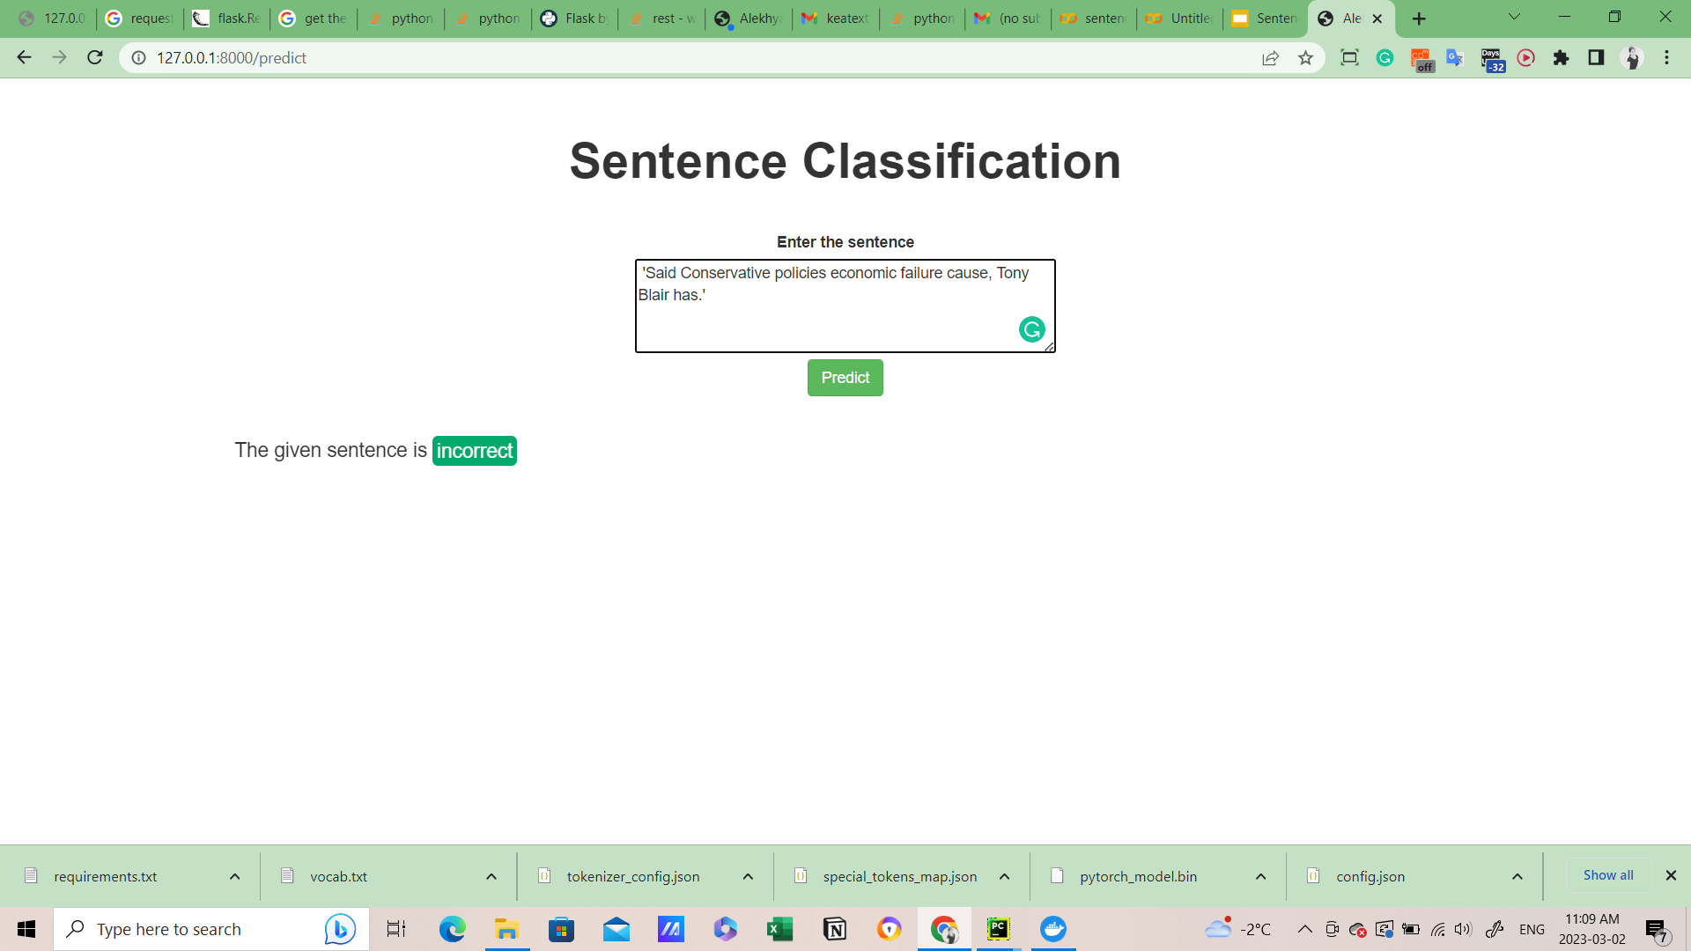
Results

Slide 15
Thank you. Questions?

